Slide 1





BASIS DATA
LANJUTAN
PRESENTATION
UAS Basis Data Lanjutan MongoDB

Slide 2




fasihul Ilmi
2 D4 Teknik Informatika A
3122600027

Slide 3
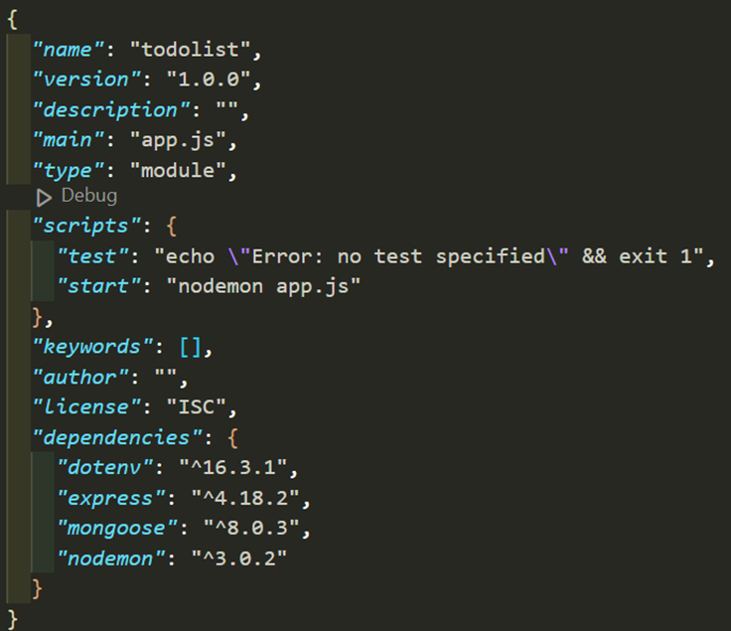
INSTALASI MODULE
Package.json

Slide 4
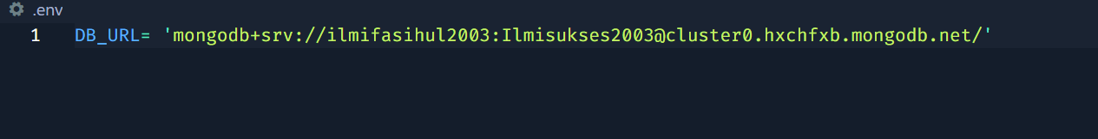
SETUP ENVironment
.env

Slide 5
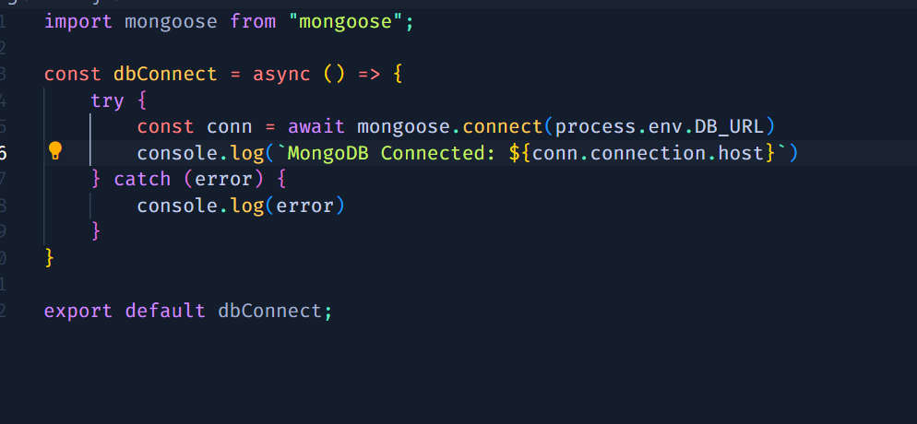
SETUP Connection
db.js

Slide 6
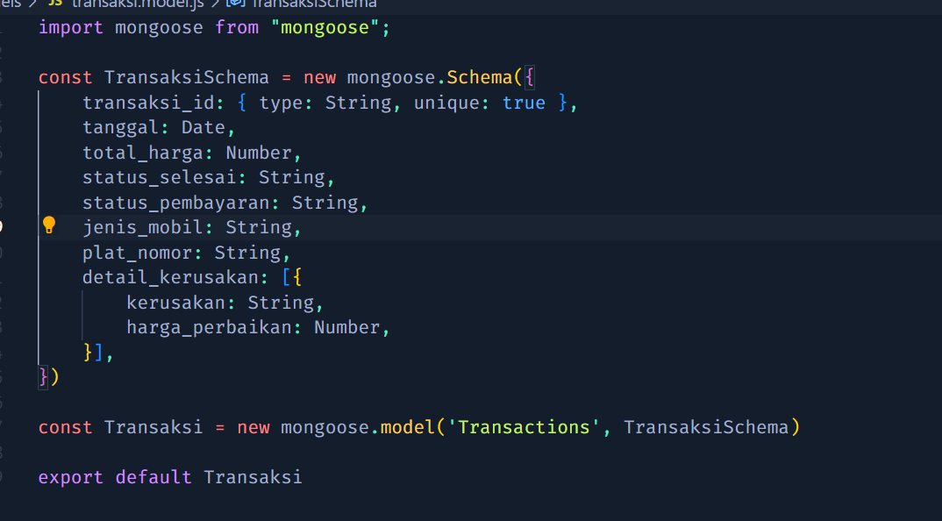
CREATE models

Slide 7
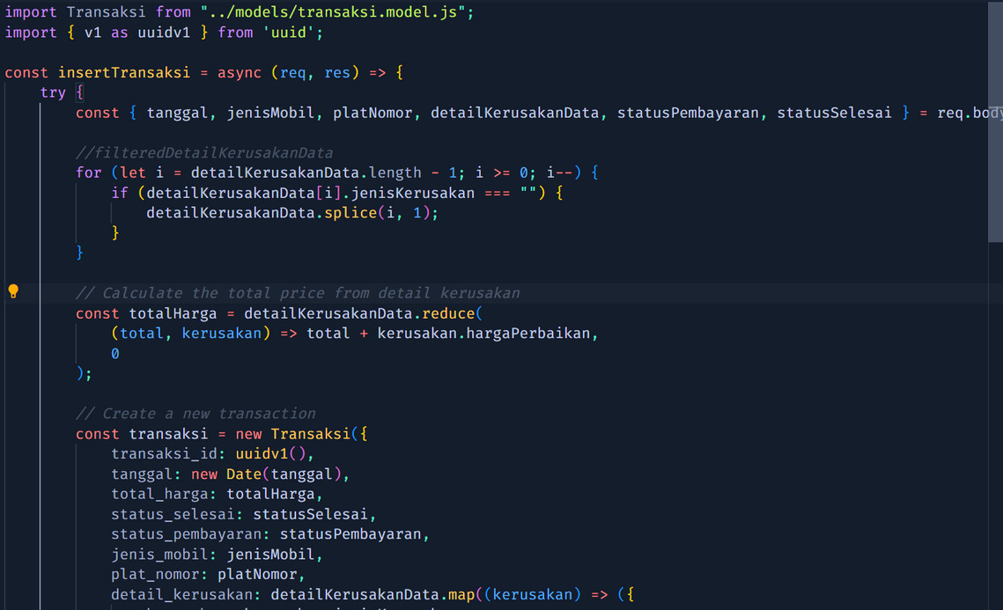
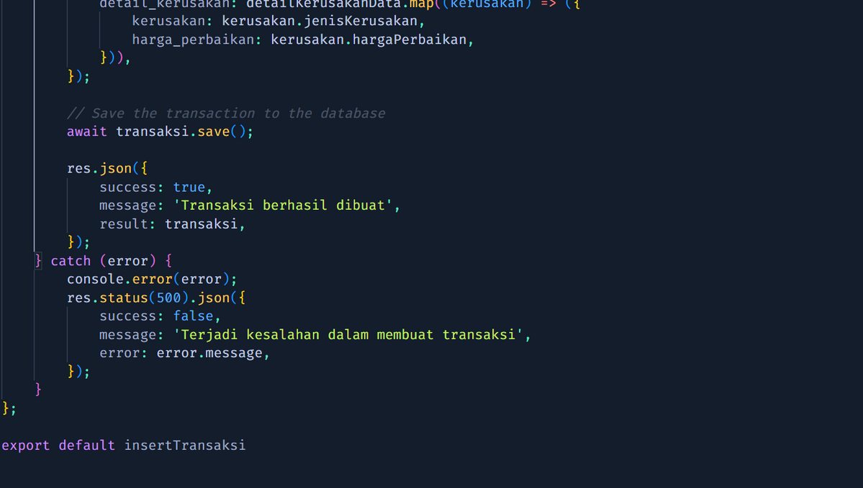
CREATE controllers
`

Slide 8
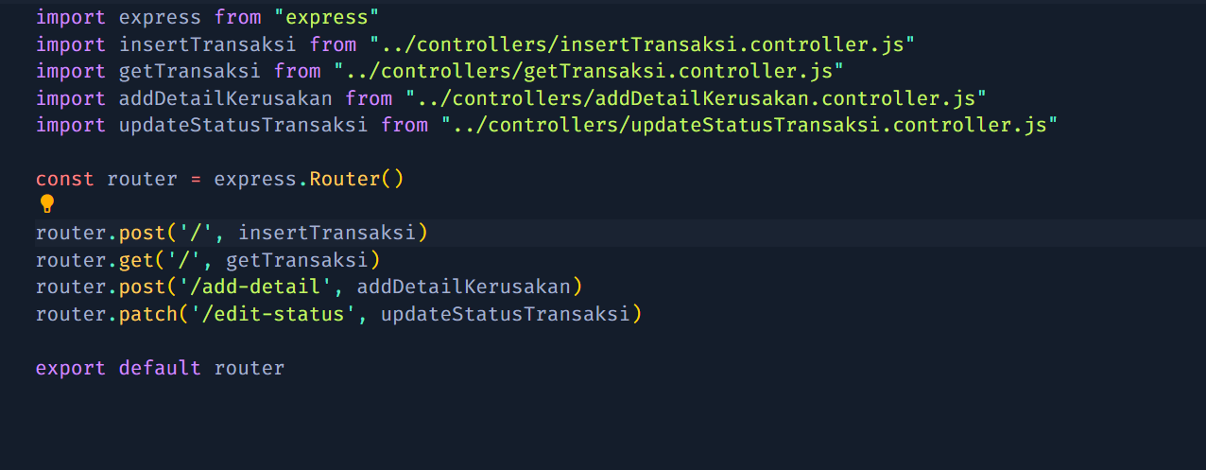
CREATE routes

Slide 9
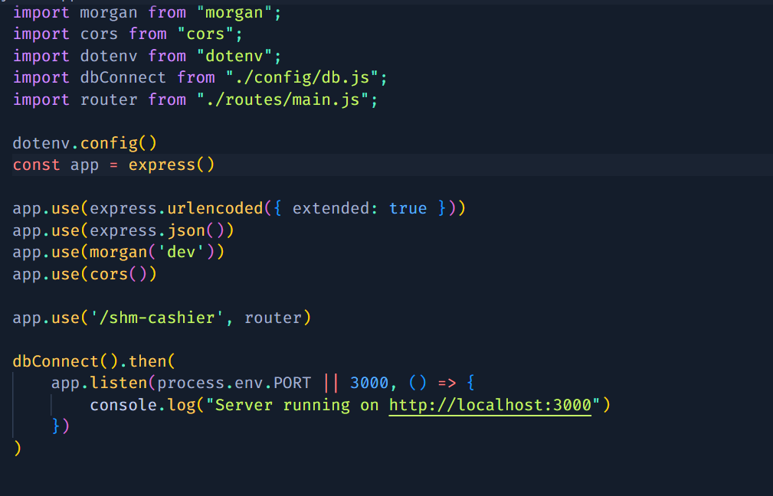
SETUP Entry point

Slide 10
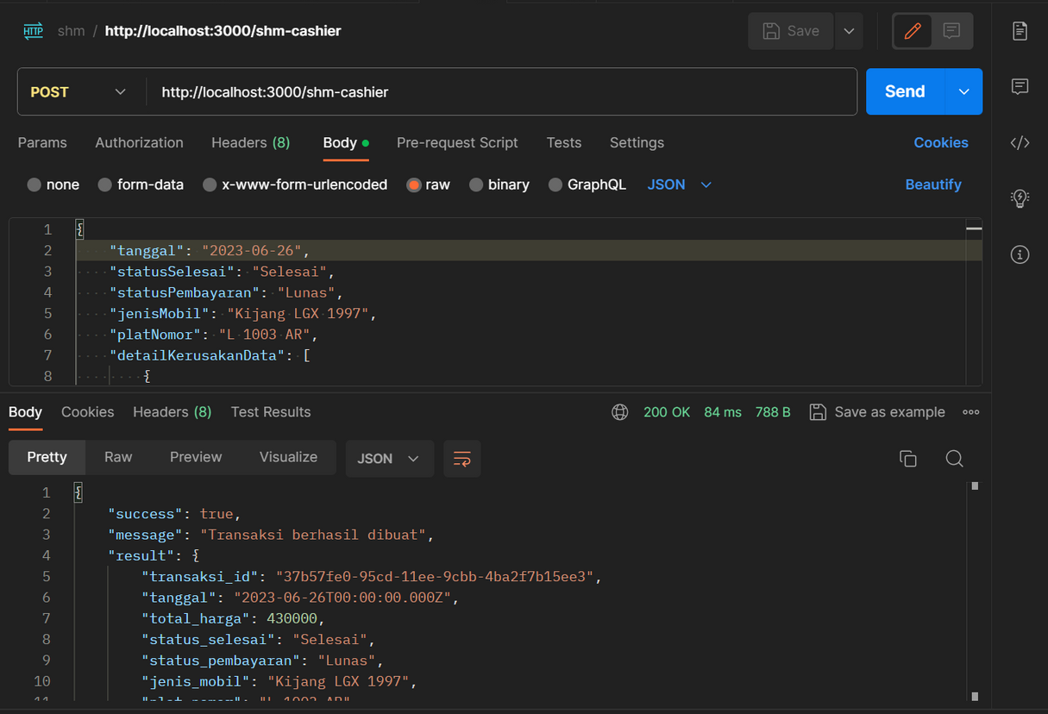
API TESTING

Slide 11
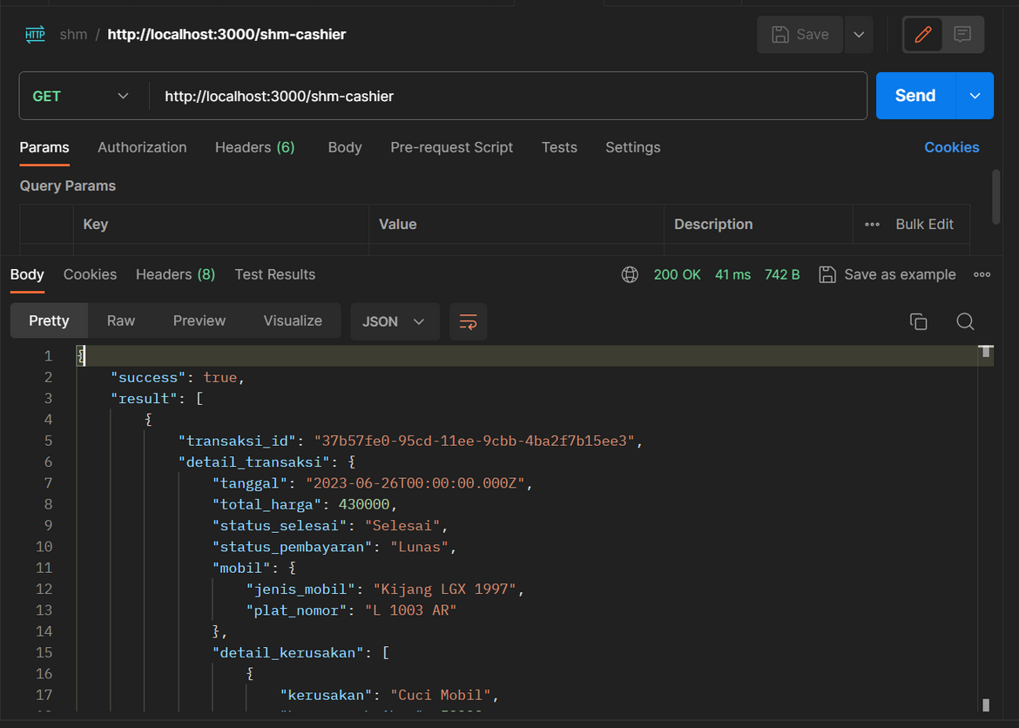
API TESTING

